Slide 1
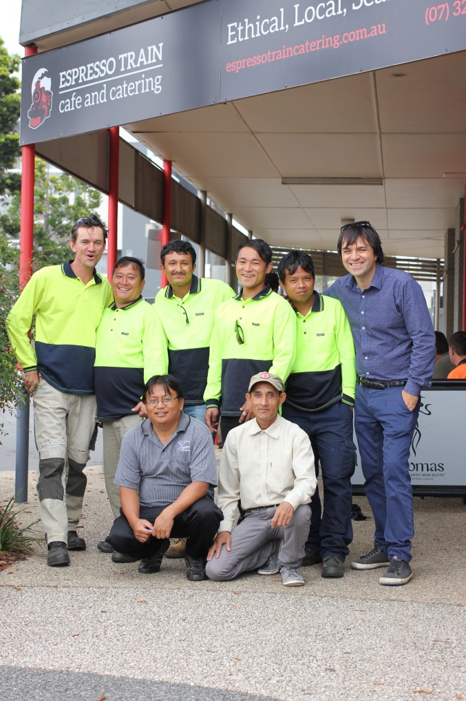
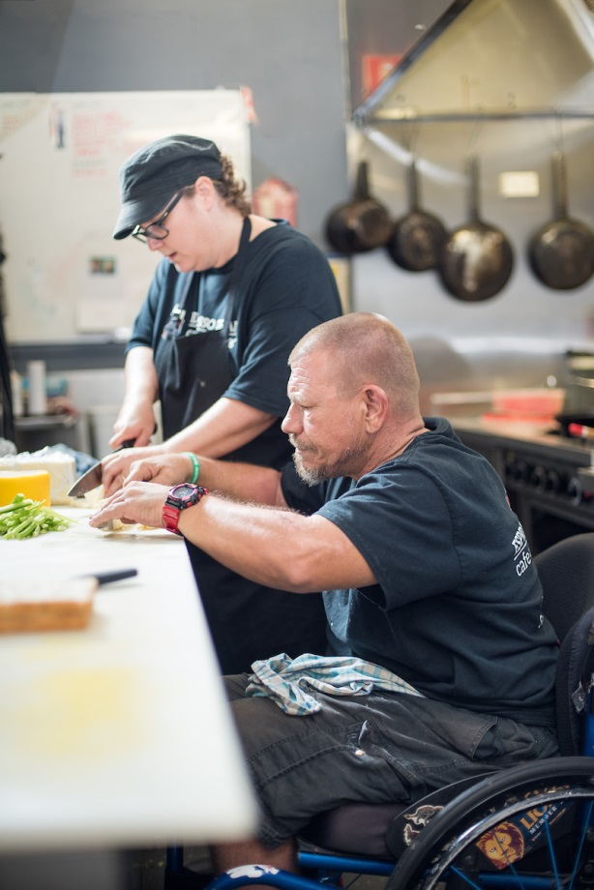
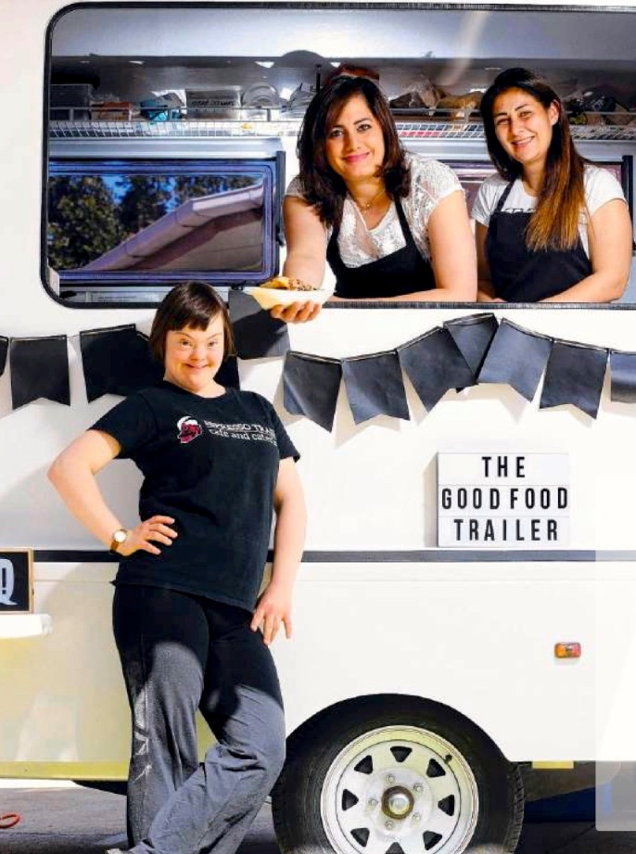
Community Development and Social Enterprise
It’s not as much of a leap as you might think!

Slide 2
If you’re working with others to address barriers you or they face - you are already an social entrepreneur!
We need to demythologise the idea of social enterprise and the ‘social-entrepreneur’.
At it’s most sustainable and effective, social enterprise is not a White Knight approach. Enterprise is normal human behaviour and can be collective work - as Mohammad Yunnus says in ‘A World of Three Zeroes’:
‘We are all social entrepreneurs - we just don’t often have the opportunity to find out”
You don’t need an MBA or even a business background to begin the journey. But to do social enterprise effectively, you will need to incorporate knowledge of business practices - if those experience and skills are not already present in the community, or in your CD toolkit.

Slide 3
Provocation
Community Development provides a fit for purpose method for developing a social enterprise, requiring little if any addition other than at a level of detail.
The key ‘movements’ in the work provide a great guide:
Go to the people (spend time building relationships and an understanding of peoples situation)
Listen to the people (look out for shared social, cultural, economic or environmental agendas)
Invite people together and support the movement from a
‘Private to public concern’. (individual problem identified as a community or structural issue e.g. ‘it’s not my fault’ and the indignation of ‘something should and can be done!’)
Support people to Build Capacity (building knowledge, relationships, resources and decision making)
If you were to add anything to this it might be helping the people to balance “Participation and Production” i.e. people’s meaningful engagement with maintenance of a productive and profitable business - a core creative tension in social enterprise. Hopefully our story will demonstrate this.

Slide 4
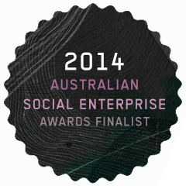
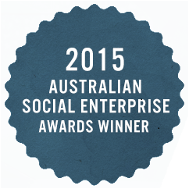
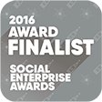
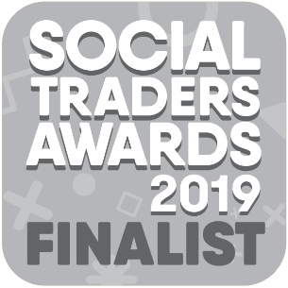
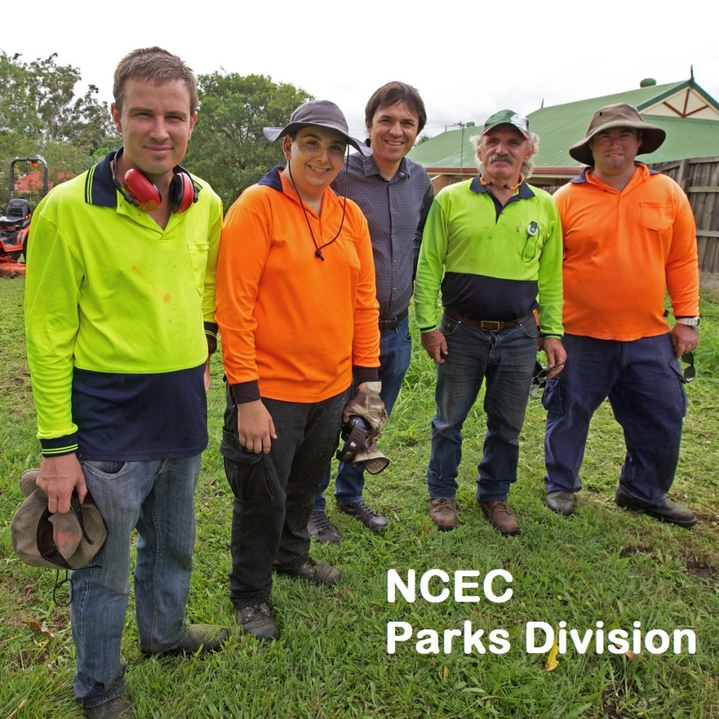
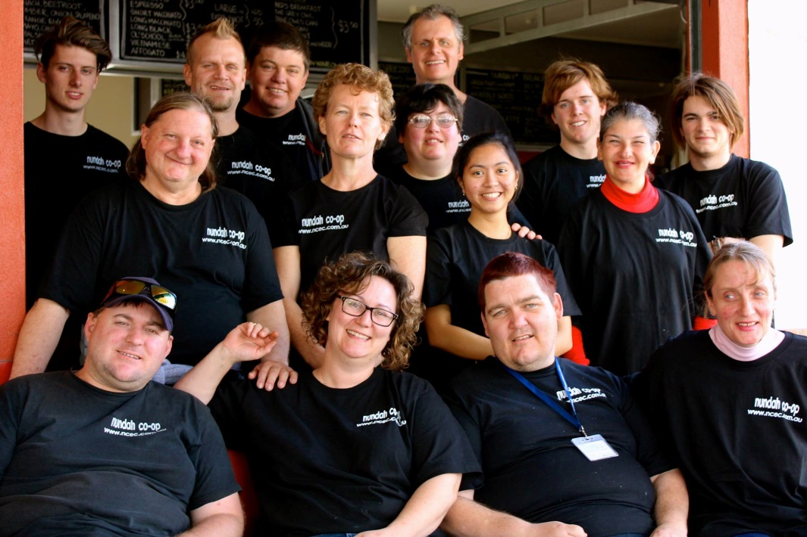
The Nundah Co-op Story
Pictured: Nundah Community Enterprises Cooperative (NCEC) Parks and Mowing and Café and Catering teams.

Slide 5
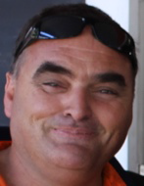
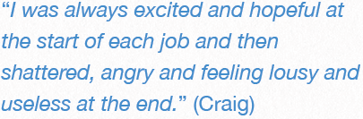
The beginning – listening to people’s stories:
Nundah Community Enterprises Cooperative (NCEC) was formed out of the aspirations of people with intellectual disabilities and mental health issues who desperately wanted to work but remained long-term unemployed. This population experience among the highest and most persistent unemployment of any in Australia. They had tried over and over to find a job - but it didn't feel like anyone was listening.

Slide 6
1995-1997:
bringing people together
In 1995 community workers in Nundah who had listened to a number of people with similar stories, suggested they meet to discuss the common issue of employment. A public meeting at the Nundah Neighbourhood Centre and the group were joined by volunteers from the centre who wanted to help. This new group decided to work together and form their own people's organisation creating meaningful employment for people with disabilities.
Over the next couple of years they:
Built relationships with each other and the local community
Experimented with different types of work
Explored models of employment creation

Slide 7
1998
Foundation and Experimentation
In 1998 the eight people from this group decided to form their own workers co-op and Social Enterprise – the first of its type in Australia. A Co-op is a type of organisation set up around the needs of members and controlled by them. This model spoke to a group who had so often been in a position of having things done to them by others.
Over the next couple of years co-op members explored a series of employment creating projects such as:
Yard mowing
Card-making
A veggie box delivery service
The group didn't wait for resources to begin this work but used those already at hand including:
Their knowledge and skills
Their connections and relationships
Unused community resources such as the basement and backyard of the Forester's Community Finance building - just around the corner from the Neighbourhood centre on Wood St
-

Slide 8
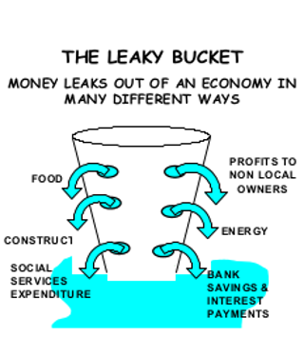
Building a Strong Community Economy by
“Plugging the Leaks”
Lot’s of money and resources come into a community but much also flows out leaving little long term benefit. In our start-up phase we focused our gaze on resources ‘leaking out’ of the community and then attempted to ‘plug the leaks’. This included:
  Local Parks that Council were paying a large Multi-National Corporation to mow.
  Local Businesses and Charities that were purchasing from caterers outside of the local community
  Job service providers and training companies receiving significant incomes but not achieving real & substantive long-term outcomes
  Rent going to private landlords
  Pay day lenders exploiting people on low incomes

Slide 9
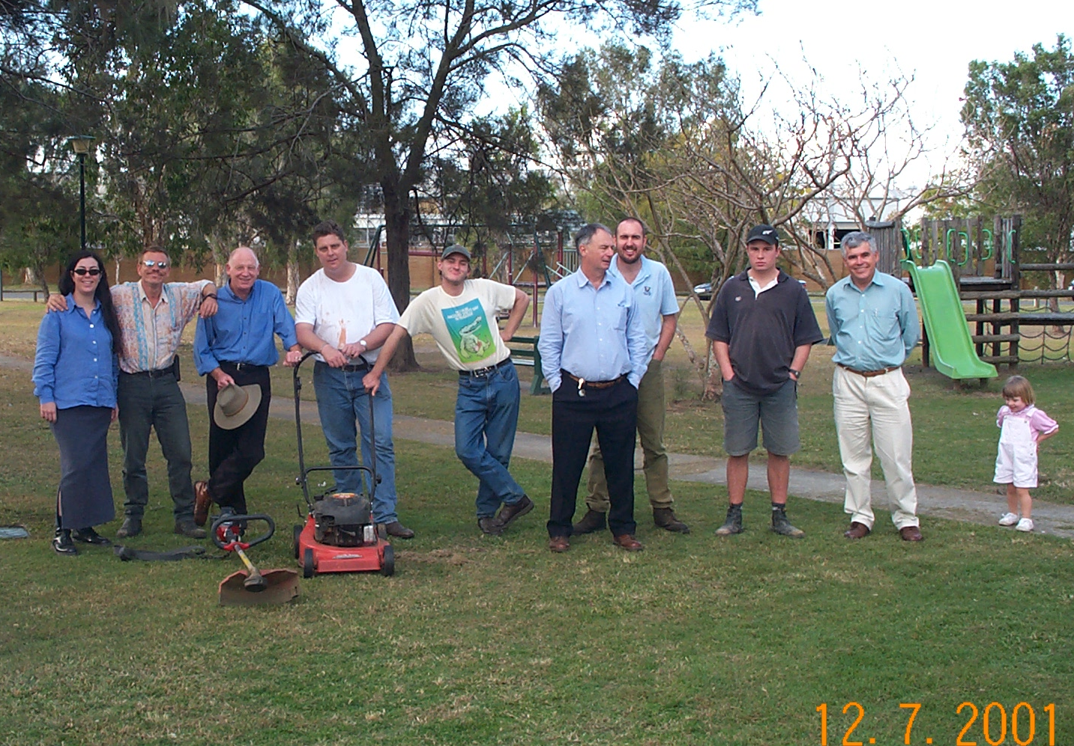
2001/2002
Establishment
Around 2001/2002 the group participated in a local government planning process and asked if they could be paid to mow two small parks. This led to the first Social Procurement in Australia. Now the group mow more than 50 parks for council and the program has spread to more than 20 other social enterprises in Brisbane.
The co-op also employed its first paid coordinator David Langdon in this year - a former social work student with a business background - whose task was to work with co-op members and help grow the business to create meaningful work opportunities for members
NCEC members mow their first park!

Slide 10
2004:
Next Steps
With the parks business successful and growing in 2004 the Co-op responded to the requests of those members who did not want this type of work.
After some deliberation, Co-op members chose to open a new business - Australia's first Social Enterprise Café: 'Espresso Train Café and Catering. The site of Espresso Train was an old pizza restaurant which had been turned into a community meeting room by Community Living Association (CLA Inc) a local disability support organisation who allowed the co-op to take-on the underutilised space.
The co-op also received its first major government grant in 2004 which was for rent for a number of years for a parks depot. Rather than paying a private landlord the Co-op members partnered with Foresters Community Finance and Community Living Association to by a community property – securing a long-term community asset.

Slide 11


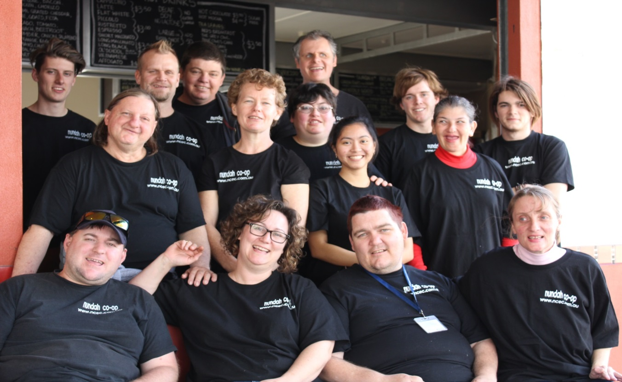
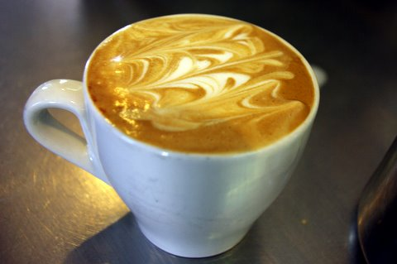


Slide 12
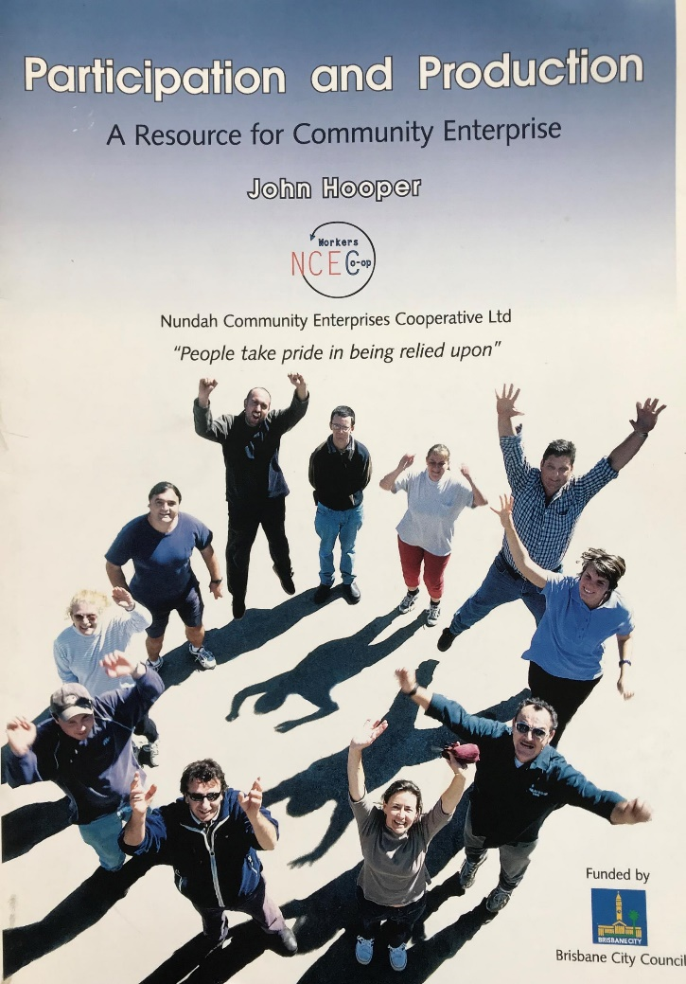
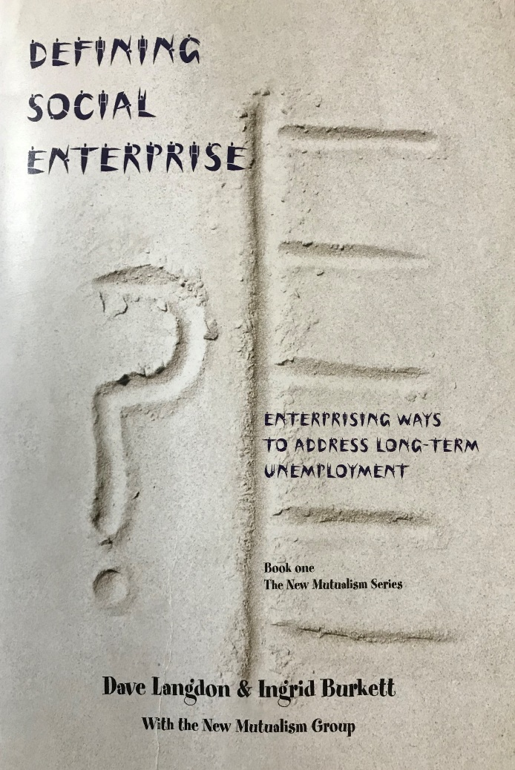
2005
Sharing the model
In 2005 the co-op started to document what it knew and build relationships with other communities on the same journey.
The Co-ops first publication was its story and framework: 'Participation and Production: A Resource for Community Enterprise'.
It also worked alongside emerging social enterprises forming the 'New Mutualism Group' which is now the Queensland Social Enterprise Council (QSEC) the first peak body for social enterprise in Australia.
This group with Dr Ingrid Burkett published the first books on Social Enterprise and Social Procurement in Australia paving the way for development of this new way of addressing market failure and complex social and environmental issues.

Slide 13
2005-2015: Consolidation and Growth
This decade was a period of consolidation and growth in this time NCEC:
Grew its parks work to more than 50 public parks and the local streetscape in Nundah Village
Received a Paul Newman grant allowing refurbishment of café space and purchase of vehicles
More than doubled its café and catering trade and opened Sundays
Doubled employment opportunities for members with disabilities (to 25 worker/members).
Opened itself to external research documenting the social impact on members and the local community
A milestone for the co-op was when founding members started to achieve paid long service leave
Supported other community enterprises to develop, including a community of refugees from Bhutan who had been unemployed in the five years since they had been in Australia.
Started a new food trailer and events business 'the Good Food Project'
Invested in a 20kw rooftop solar farm halving its carbon footprint and saving many thousands of dollars p.a.
Was awarded Australia's Best Social Enterprise (2015)

Slide 14
Some Migrant-Led and Social Enterprise Businesses
NCEC has supported

Slide 15
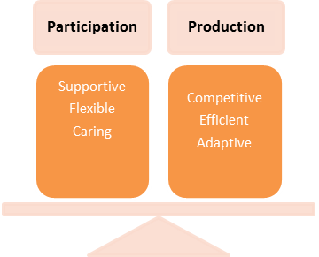
Operating Framework:
‘Participation and Production’
NCEC has a primary purpose to create meaningful work for members with a disability.
As a cooperative enterprise which chooses to derive the majority of its income from trade, NCEC must balance the twin goals of ‘member participation’ and ‘business productivity’.
“Participation and Production : A Resource for Community Enterprise” free e-book available @ ncec.com.au

Slide 16
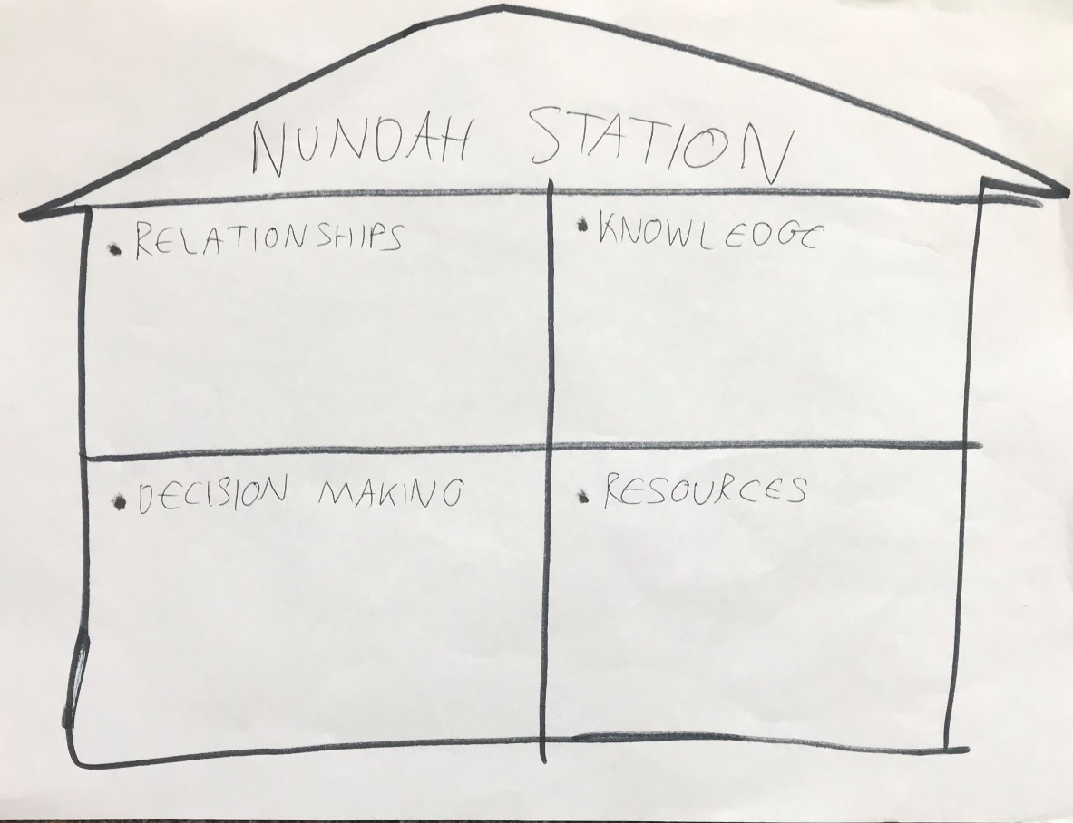
Building People's Capacity - Brick by Brick.
NCEC started humbly but built capacity by looking to four key areas:
Relationships: e.g. What relationships do we already have and how can they be strengthened? What new relationships do we need?
Knowledge: What knowledge do we already have and what new knowledge to we need? ((e.g. cultural, technical, industry, business, financial knowledge etc)
Resources: What resources do we already have and what new resources do we need (e.g. financial, assets, equipment, materials etc)
Decision Making: How do we make decisions and why? Where could we improve decision making in the co-op to improve our member focus, business capacity and/or community involvement.
The 'cement' in all if this are our values (next slide)

Slide 17
NCEC Values: holding it all together
Clarity of purpose: a core commitment to long-term employment of members with a disability.
Ownership: 'We built it' and 'it is our co-op', 'what we say goes'.
Mutuality: the co-op helps members but the members have a role to play in helping the co-op
Listening: deep listening to members with disability and especially those who have been forgotten about or misunderstood
Gentleness: being friendly, kind and respectful to each other
Caring for community and environment: reaching out beyond the co-op to help others and the planet
Enterprise: making sure our businesses work
Fun and Celebration: celebrating achievements and our time together

Slide 18
2016-2020
Revisiting our Cooperative roots
As time passed and we gained a greater level of professionalism as an enterprise there was also some awareness that the co-op was at risk of becoming just another workplace. To this end we:
Revisited our rules ensuring the place of members with intellectual disability and ensuring majority representation on the board of Directors
38 worker/members from disadvantaged backgrounds now in NCEC
- Invested in relationship building and education of members as to the story of the co-op - primarily through forming of a speaker's group and monthly members meetings
- Engaged in an action research project with Academics Dr Peter Westoby and Dr Lynda Shevellar (published in 2017)
- Maintained a degree of independence by diversifying contracts (gaining of our first corporate contract) and choosing not to be reliant on grants and refusing to apply for those that did not align with our member centric vision.

Slide 19
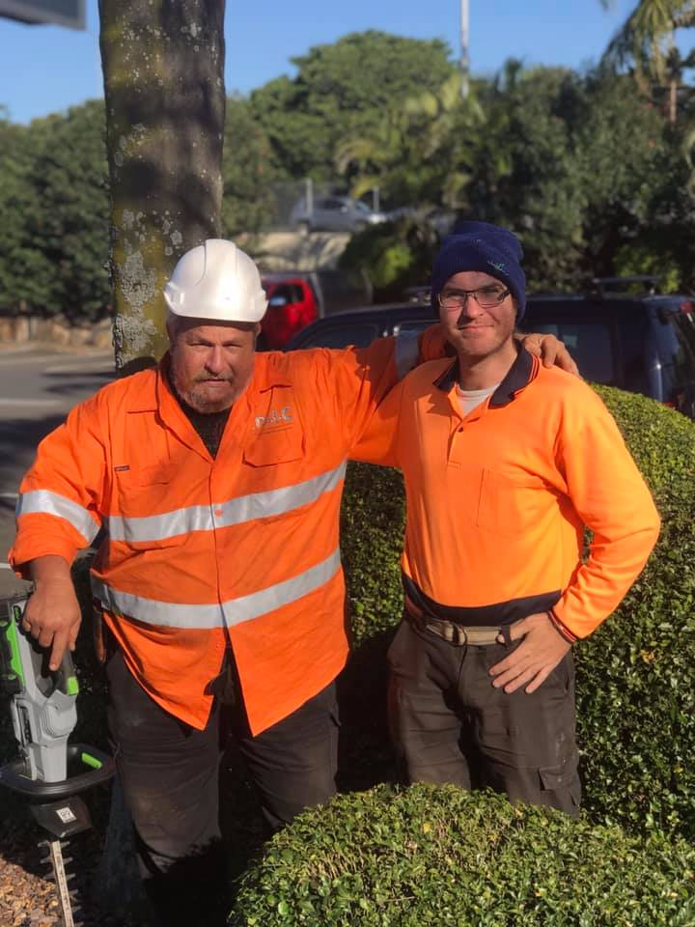
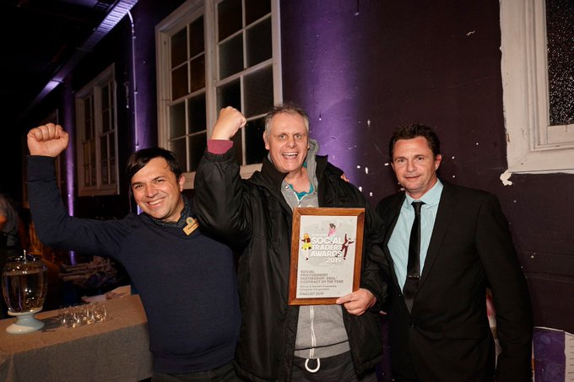
Local people looking after their Local Shopping Centre - our Partnership with Mirvac Corporation

Slide 20
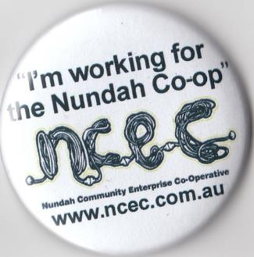
Why a Community Enterprise?
The majority of NCEC members had made repeated attempts to gain supported or open employment in the past without success.
Controlling their own successful business has given them long-term work as well as a say and influence around job design, workplace culture and a sense of ownership (i.e. ‘that this is our place’).
There’s been a fundamental from ‘customer or recipient‘ to ‘participant and producer’.

Slide 21
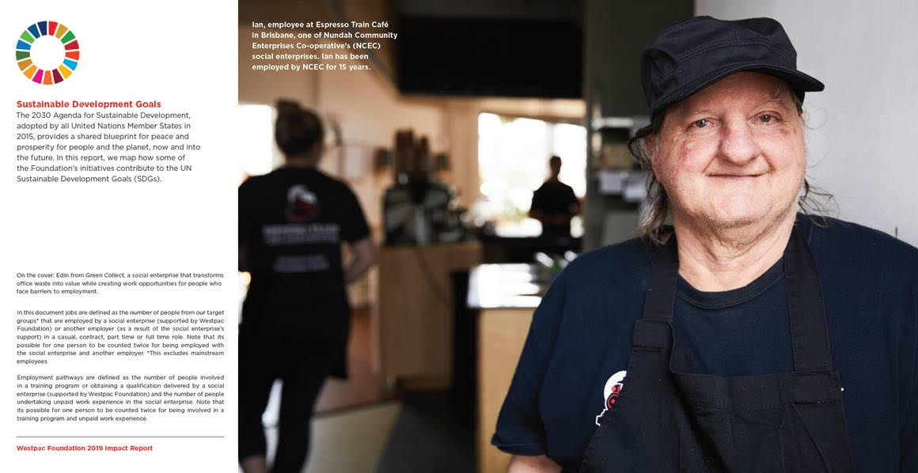
N.C.E.C. members report significant improvements in health and well being, due to having:
- A valued role
- Meaningful use of time
- Improved personal finances
- A sense of ownership.
From the original 8 there are 40
Worker/Members in employment!

Slide 22
Learnings for Community Worker's
C.D. can be a powerful method of addressing complex disadvantage and uniquely suited to those without power - it can begin with the relationships and resources at hand.
-Mid-size organisations are ideally suited to the work - being small enough for local people to have a role and share of responsibility - whilst being large enough to have an impact on the problem at hand
Not having the voice of participants at the center of the work is like driving blindfolded: it would be pure luck to get where you wanted to go and you're likely to cause harm in the process
An unconscionable problem and commitment by people to address it is the engine-room of enterprise & more valuable than any other contribution including $$$
If we don’t work in ways that build ownership of a problem and cede a level of control to the people affected by it, how else will they address the root causes of their exclusion?

Slide 23
Common Features of Successful Community Enterprises
Grounded in agendas of a community
Works in the cracks to ‘mop-up’ systemic failures
Embedded in a network of supportive community partners and engages with wide range of local actors
Strong, clearly communicated partner relationships: often with a local service organisation and/or with a local institution or business in the form of an ‘Anchor Contract’.
Blended income: a mix of traditional community org income with income from a trading
Is a hub of innovation, pioneering social and environmental practices that can enrich the mainstream
Jobs multiplier (often ‘punch above their weight’ to create more jobs and more sustainable ones)

Slide 24
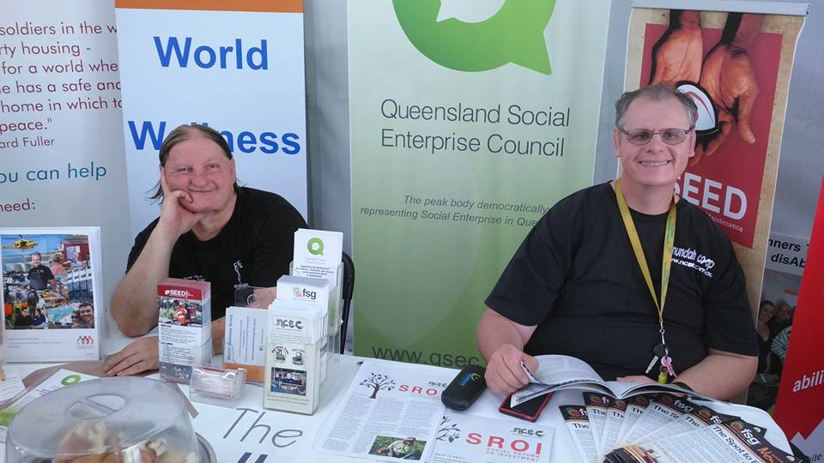
How to Begin…
The thousand kilometre journey starts with a single step!
Some thoughts:
Start small but think big!
Start with who and what you know
Build relationship with each other and an identity, a sense of community and team-work
Define your core –purpose / reason for being (a public concern) this is the fire that drives a community business
Identify economic opportunities that match with members abilities and needs
Trial / Experiment on small scale (its ok to fall down as long as you can get up again)
Build capacity by looking to relationships, resources, knowledge and decision making
When ready develop formal strategic or business plan
Reach out to others on the same journey e.g. QSEC

Slide 25
Selected Resources:
Recent action research on NCEC titled ‘The Possibility of Cooperatives’ https://www.tandfonline.com/doi/abs/10.1080/09687599.2019.1594699?af=R&journalCode=cdso20
Mountain Mowing Men video: https://vimeo.com/302663983
- ‘Get Mutual’ Co-op Builder Website with Case studies etc
https://www.getmutual.coop/
- NCEC Website with free story of Nundah Co-op “Participation and Production a resource for community enterprise” on “Publications Page”
www.ncec.com.au
- A critical perspective: Prof Jo Barraket’s opinion piece on Social Enterprise
‘

